Slide 1
Saqib Gulam Hussain Shaikh
Pizza Sales Analysis Report
Introduction:
Introduction
Hi! I made this Pizza Sales Dashboard in Power BI with the dataset I’ve been provided by Unified Mentors.
The goal of this Power BI project is to analyze pizza sales across different dates, times, and product categories by using metrics such as order volume, revenue, and average order value, TO help find opportunities to drive more sales & work more efficiently.
This study will help us get a clearer picture of customer demand patterns and give useful insights into sales performance and restaurant operations.
Data: About Dataset Contents, This pizza sales dataset make up 12 relevant features:
● order_id: Unique identifier for each order placed by a table
● order_details_id: Unique identifier for each pizza placed within each order (pizzas of the same type and size are kept in the same row, and the quantity increases)
● pizza_id: Unique key identifier that ties the pizza ordered to its details, like size and price
● quantity: Quantity ordered for each pizza of the same type and size
● order_date: Date the order was placed (entered into the system prior to cooking & serving)
● order_time: Time the order was placed (entered into the system prior to cooking & serving)
● unit_price: Price of the pizza in USD
● total_price: unit_price * quantity
● pizza_size: Size of the pizza (Small, Medium, Large, X Large, or XX Large)
● pizza_type: Unique key identifier that ties the pizza ordered to its details, like size and price
● pizza_ingredients: ingredients used in the pizza as shown in the menu (they all include Mozzarella Cheese, even if not specified; and they all include Tomato Sauce, unless another sauce is specified)
● pizza_name: Name of the pizza as shown in the menu

Slide 2
Problem Statement:
Plato’s Pizza have collected sales data for the past year, and the restaurant would like to use this information to improve its business.
By analyzing the dataset provided, we can understand customer behavior, sales trends, and operational efficiency.
Here are some questions that we’d like to be able to answer:
What days and times do we tend to be busiest?
How many pizzas are we making during peak periods?
What are our best and worst-selling pizzas?
What’s our average order value?
How well are we utilizing our seating capacity? (we have 15 tables and 60 seats)

Slide 3
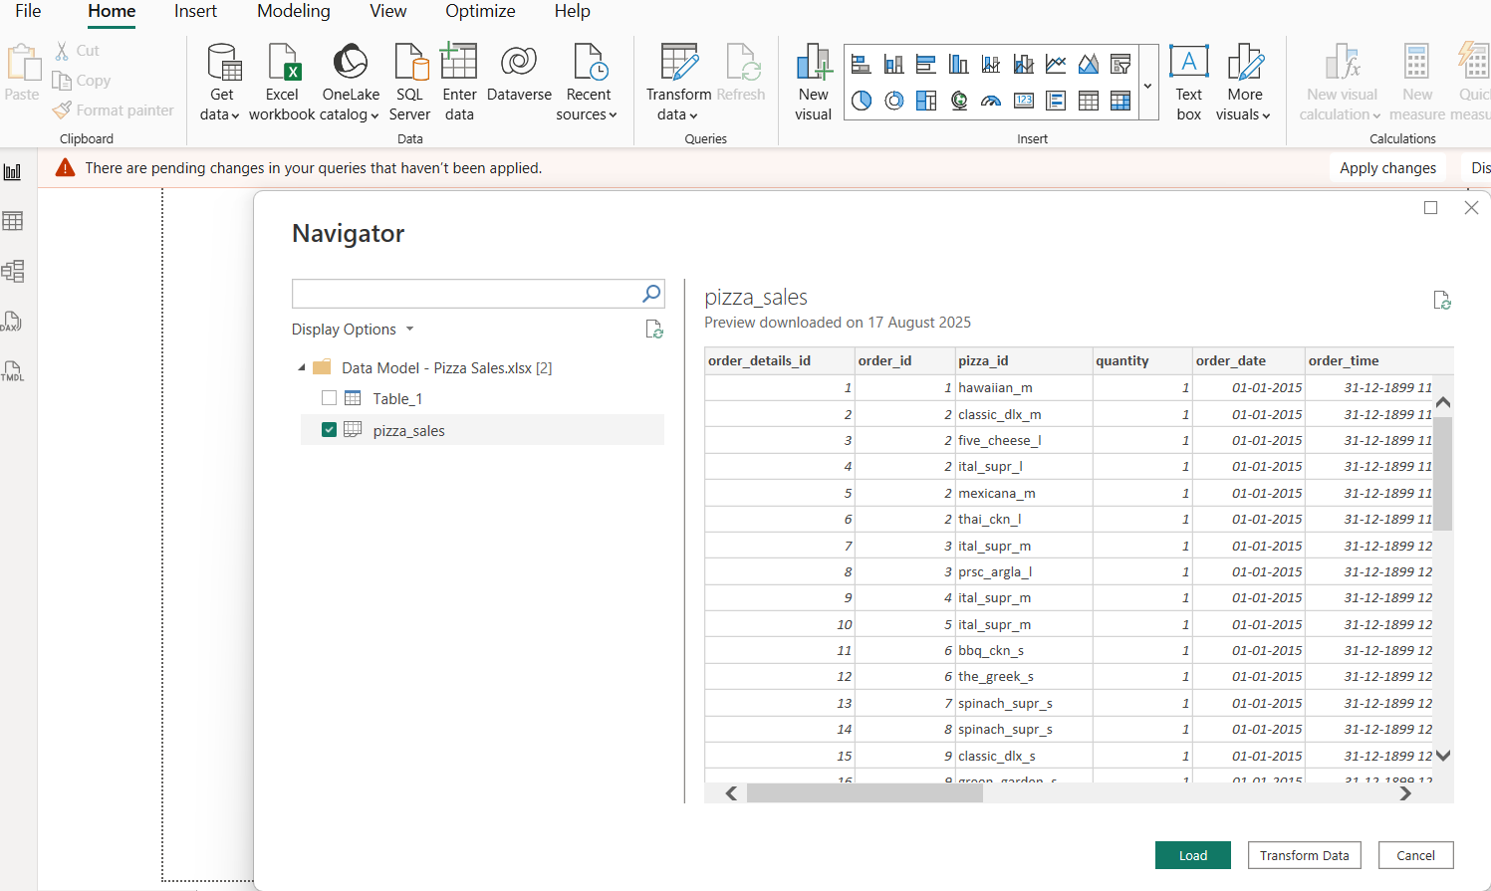
Task 1: Data Import and Preparation
Connect to Data: Importing Data

Slide 4
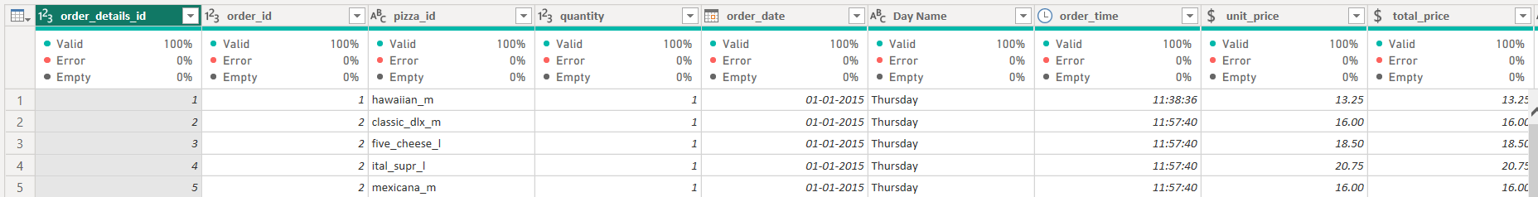
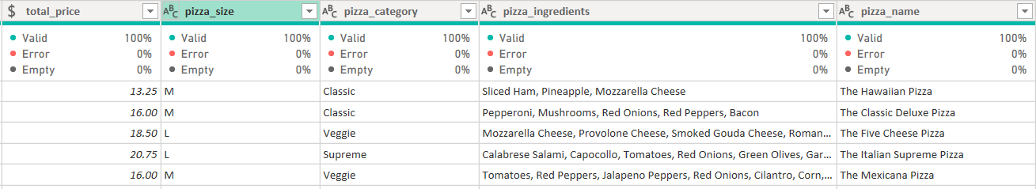
Data cleansing
In order to clean the data: 1) I’ve changed the unit price date type to currency.
2) Extracted Time
3) Inserted a Custom Column = Day of the week By using Formula: Date.DayOfWeek([order_date])
4) Inserted Day Name
5) Inserted an Hour Column. By using Formula: Time.Hour([order_time])
After the Data Cleansing we have ourselves Data looking like this:

Slide 5
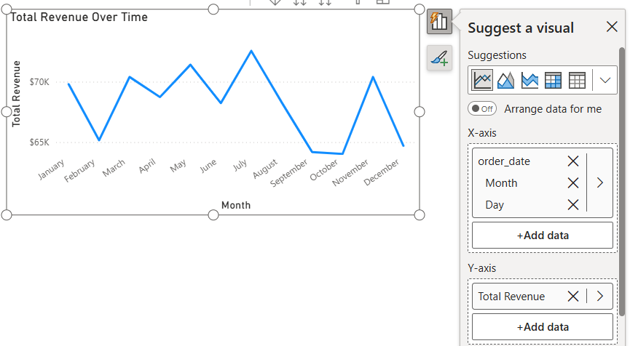
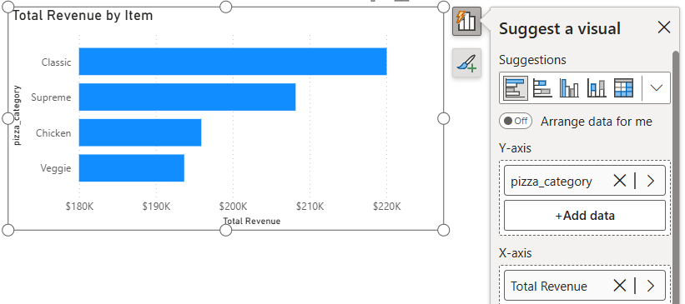
Step 2: Creating Basic Chart
Total Revenue Over Time:
■ Drag Date to Columns.
■ Drag Revenue to Rows.
■ Change the chart type to a Line Chart.
Revenue by Item:
■ Drag Item to Columns.
■ Drag Revenue to Rows.
■ Use a Bar Chart to display revenue by item.
This charts can help us answer: What are our best and worst-selling pizzas?

Slide 6
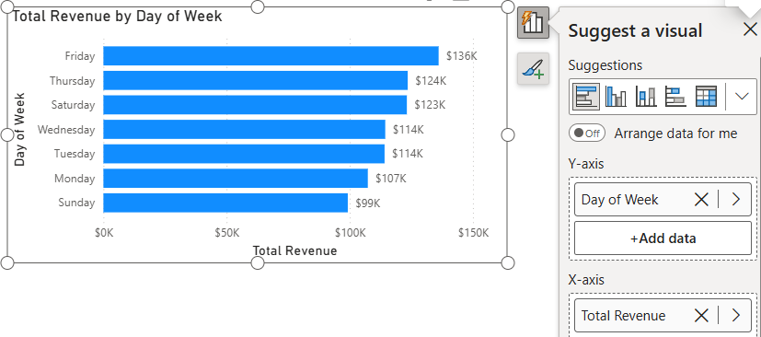
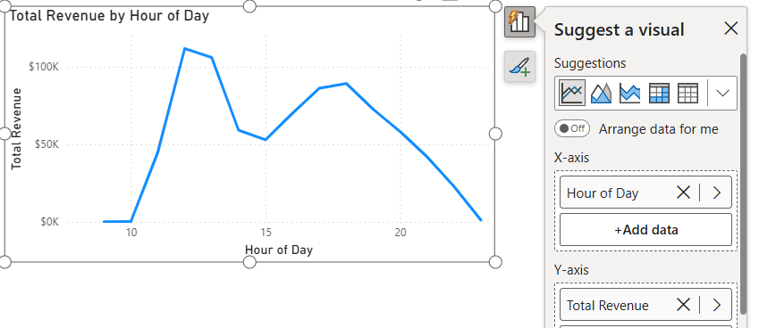
Revenue by Day of Week:
Here I’ve used the calculated field (day of the week) :
■ Drag Day of Week to Columns.
■ Drag Revenue to Rows.
■ Use a Bar Chart to show revenue by day of the week.
Revenue by Time of Day:
Here I’ve used the calculated field that I’ve created (hour of the day) :
■ Drag Hour of Day to Columns.
■ Drag Revenue to Rows.
■ Use a Line Chart to show revenue by hour of the day.
These 2 charts can help us answer: What days and times do we tend to be busiest?

Slide 7
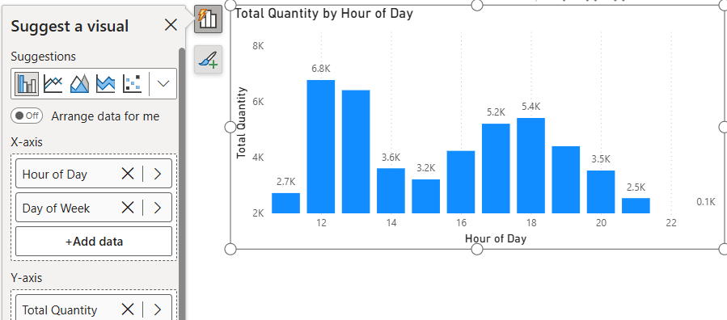
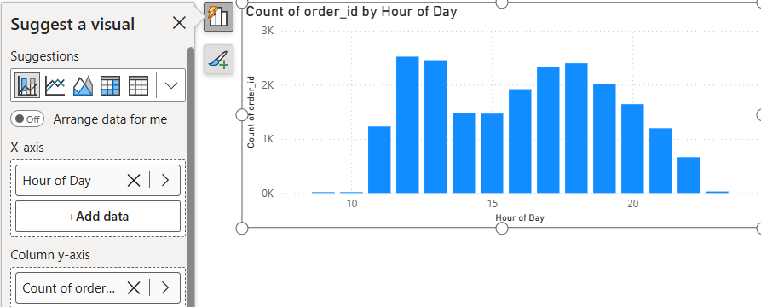
In Order to answer: (How many pizzas are we making during peak periods? )
Here, I’ve created 2 more Charts: Total Quantity by Hour of the day and day of the week:
■ Drag Day of Week & Hour of Day to X axis
■ Drag Total Quantity to Y axis.
■ Use a Column Chart to Total Quantity by Hour of the day and day of the week.
Count of Orders By Hour Of Day:
■ Drag Hour of Day to X axis.
■ Drag Count of Order ID to Y axis.
■ Use a Line Column chart to show revenue by hour of the day.
The chart Orders By Hours can also help us answer: How well are we utilizing our seating capacity

Slide 8
Findings as per Problem Statement:
1) What days and times do we tend to be busiest?
Total Revenue by Day of Week (Bar chart) : Shows which days bring in the most revenue (Friday is the busiest day, followed by Thursday and Saturday; Sunday is the slowest).
Total Revenue by Hour of Day (Line chart) : Reveals peak hours (highest sales around lunch ~12 PM and dinner ~7 PM).
Count of Orders by Hour of Day (Bar chart, 1st page) → Confirms order activity by time, showing when the kitchen is most active.
Together, these charts answer when the restaurant is busiest, both by day and by hour.
2) How many pizzas are we making during peak periods?
Total Quantity by Hour of Day (Bar chart, 1st page) : Shows number of pizzas made per hour. Example: peak ~6.8K pizzas around 12 PM and ~5.4K around 6 PM.
Count of Orders by Hour of Day (1st page) : Supports this by showing order volume per hour.
These directly answer the number of pizzas being made during the busiest hours.
3) What are our best and worst-selling pizzas?
Total Revenue by Item (Bar chart, 1st page) : Classic pizza is best-selling ($220K revenue), followed by Supreme, Chicken, and Veggie. Veggie is the lowest among the four.
This identifies top- and bottom-performing pizza categories.
4) What’s our average order value?
Created a new Card Visual: Average Order Value card : Clearly shows $16.82.
Just a KPI card can answers this correctly as well.
5) How well are we utilizing our seating capacity ?
Count of Orders by Hour of Day (Bar chart, 1st page) : This gives an idea of how many orders come in per hour, which can be compared to seating capacity.
While there’s no direct “seating utilization” chart, the Count of Orders visual + known seating capacity can allows us to analyze whether demand exceeds seating.

Slide 9
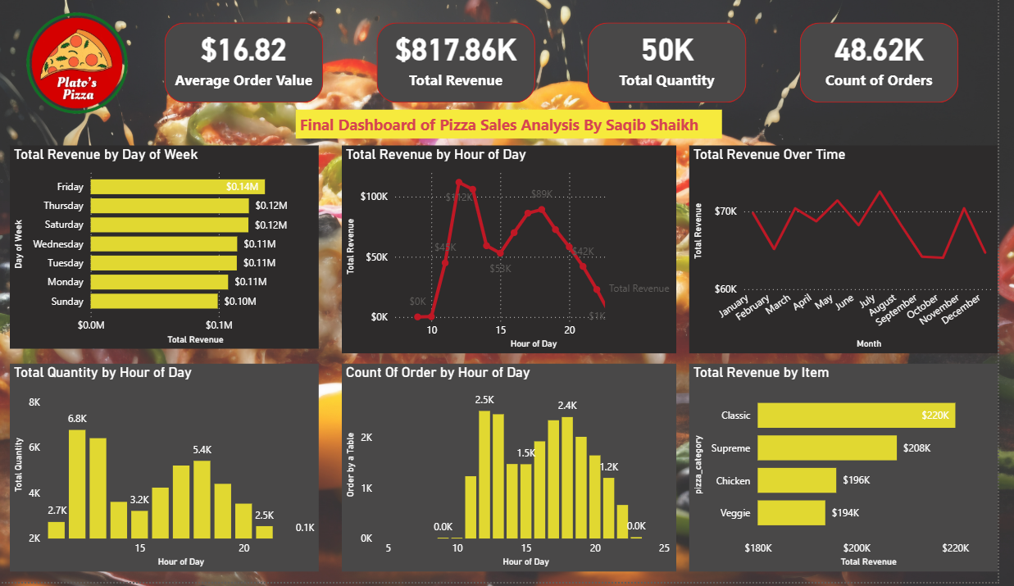
The Final Dashboard
Final Dashboard Consists of 2 Pages:
1: Sales Report Page

Slide 10
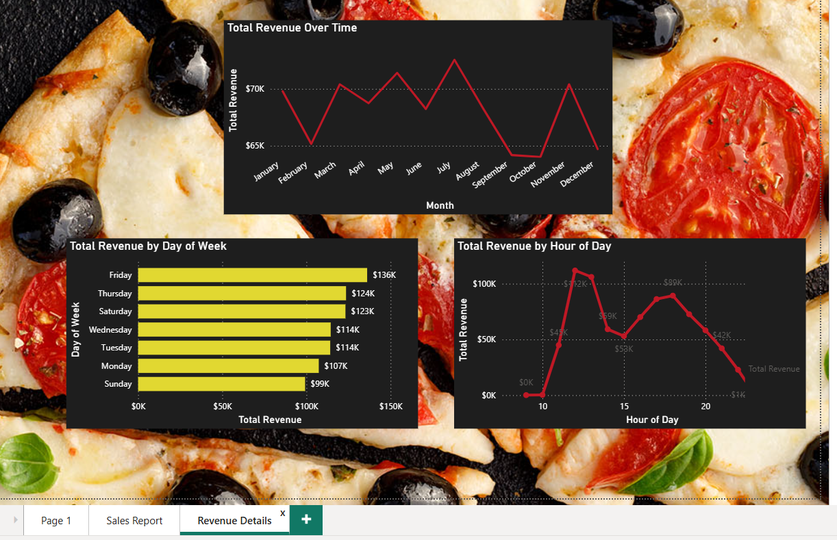
Final Dashboard
2: Revenue Details Page:
Thank You

